Slide 1
AI-GIS BASED MOBILE APPLICATION FOR TRACKING DEEP SEA FISHERMEN
A.V.C. COLLEGE OF ENGINEERING
DEPARTMENT OF ELECTRONICS AND COMMUNICATION
Presented by
S. Sivapriya (820320106022)
G. Udhaya (820320106026)
S. Vishwaja (820320106029)
GUIDE NAME: Dr. C. Jayasri

Slide 2
Abstract
A technology for real-time tracking in low-connectivity deep-sea environments is crucial for enhancing the safety of fishermen. This project aims to address this challenge by creating an AI-based Geographic Information System (GIS) app.
Leveraging advanced algorithms, the app will accurately detect and track deep-sea fishermen's locations during maritime activities.
With a user-friendly interface, the app will provide comprehensive monitoring, ensuring safety in remote and challenging environments.
The anticipated outcome is an innovative GIS app that significantly improves tracking capabilities, contributing to enhanced safety measures and efficient maritime activities, thus positively impacting the well-being of deep-sea fishermen.

Slide 3
Objective
An AI-based Geographic Information System (GIS) application specifically tailored for detecting and tracking the locations of fishermen engaged in deep-sea fishing activities. By leveraging advanced artificial intelligence and machine learning algorithms, the app aims to accurately pinpoint the real-time whereabouts of fishermen operating in remote and low-connectivity deep-sea environments.
The goal of project the is to enhance safety measures for fishermen by providing timely and reliable location information, thereby mitigating risks associated with maritime activities in challenging oceanic conditions.

Slide 4
Introduction
Deep-sea fishing is a vital industry contributing to global food supply and economic prosperity, yet it poses significant challenges due to the remote and unpredictable nature of the marine environment. One of the foremost concerns in deep-sea fishing is ensuring the safety and well-being of fishermen who navigate these treacherous waters.
Despite advances in maritime technology, the lack of reliable and continuous communication infrastructure in deep-sea locations presents a formidable barrier to establishing effective real-time tracking systems for fishermen.
Recognizing the critical need to address this safety gap, our project endeavors to develop an innovative AI-based Geographic Information System (GIS) application tailored specifically for detecting fishermen's locations during deep-sea fishing activities.

Slide 5
Existing System
LiFi-based fishermen tracking system using GPS incorporates visible light communication (VLC) technology to enhance the accuracy and reliability of tracking fishermen in maritime environments.
Additionally, LiFi technology provides inherent advantages such as increased security, immunity to electromagnetic interference, and reduced latency, making it an ideal solution for enhancing the efficiency and safety of maritime operations.
Disadvantages:
Limited Coverage Area
Weather Dependence
Interference from Obstructions
High Implementation Cost
Compatibility with Existing Infrastructure

Slide 6
Proposed System
An AI-based Geographic Information System (GIS) application specifically tailored for detecting and tracking the locations of fishermen engaged in deep-sea fishing activities. Leveraging advanced artificial intelligence and machine learning algorithms, the app will analyze relevant data such as GPS coordinates, environmental conditions, and vessel movements to provide real-time location information.
This innovative solution will offer a comprehensive and user-friendly interface for effective monitoring, ensuring the safety of fishermen operating in remote and challenging deep-sea environments. By improving tracking capabilities and enhancing safety measures, the proposed system aims to contribute to the efficiency and well-being of deep-sea fishermen while addressing critical aspects of maritime safety.

Slide 7
Advantages
Enhanced safety through monitoring.
Accurate real-time location tracking.
User-friendly interface for monitoring.
Effective utilization of AI.
Improved efficiency and well-being.

Slide 8
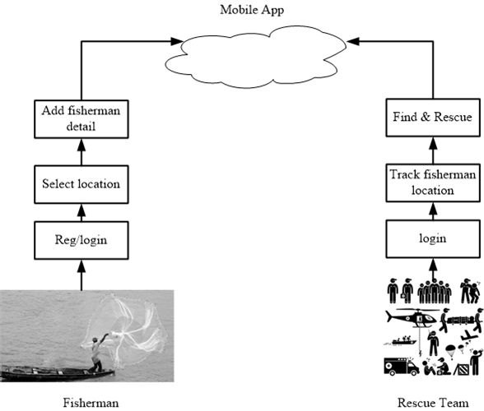
Block Diagram

Slide 9
Modules Description
Geographic Information System (GIS) Application Development Module: Focused on creating the user-facing application, this module develops the AI-GIS based mobile application for tracking deep sea fishermen. It incorporates the developed AI algorithms to provide real-time location information and ensures a comprehensive and user-friendly interface for effective monitoring.
Safety Enhancement and Impact Assessment Module: This module evaluates the effectiveness of the developed GIS app in enhancing safety measures for deep-sea fishermen. It assesses the impact of the tracking solution on maritime activities, efficiency, and the well-being of fishermen. Feedback from users and stakeholders is gathered to refine the system and ensure it meets the project's objectives.
AI Algorithm Development Module: This module is dedicated to the development of AI algorithms tailored for detecting and tracking the locations of deep-sea fishermen. It involves designing and training machine learning models to analyze relevant data, including GPS coordinates, environmental conditions, and vessel movements, to provide accurate real-time location information.

Slide 10
Low-Connectivity Technology Development Module: Focused on developing technology capable of operating in low-connectivity areas, this module explores innovative solutions such as LiFi (Light Fidelity) or satellite communication systems. It aims to overcome communication challenges by leveraging advanced technologies suitable for maritime environments with limited connectivity.
Communication Infrastructure Assessment Module: This module evaluates the existing communication infrastructure in deep-sea locations to identify limitations and challenges in establishing real-time tracking systems. It assesses the reliability and continuity of communication networks and determines areas with low connectivity, guiding the development of the tracking solution.

Slide 11
System Requirement
HARDWARE REQUIREMENTS
Processors: Intel® Core™ i5 processor 4300M at 2.60 GHz or 2.59 GHz (1 socket, 2 cores, 2 threads per core), 8 GB of DRAM
Disk space: 320 GB
Operating systems: Windows® 10, macOS*, and Linux*
SOFTWARE REQUIREMENTS
Server Side : Android studio
Client Side : HTML, CSS, Bootstrap
IDE : Flask 1.1.1
Back end : MySQL 5.
Server : WampServer 2i
OS : Windows 10 64 –bit or Ubuntu 18.04 LTS “Bionic Beaver”

Slide 12
Conclusion
The development of an AI-GIS based mobile application for tracking deep sea fishermen locations in deep-sea fishing environments represents a significant step forward in enhancing maritime safety and efficiency. By leveraging advanced artificial intelligence this innovative solution offers real-time location information and effective monitoring capabilities, ensuring the safety of fishermen operating in remote and challenging deep-sea environments.
The comprehensive and user-friendly interface of the GIS app facilitates seamless integration into fishermen's workflow, contributing to improved safety measures and efficient maritime activities.

Slide 13
References
Kesavan TK and Lakshmi K, “GSM-Based Smart Marine Tracking System for Location Monitoring and Emergency Protection”, 2022.
Tharwin Kumar R, “Fisherman Border System Based on IOT Fisherman Border Alert System Based on IOT”, vol. 1, pp. 37-44, 2022.
Thomas T and Mary M, "A WSN-based maritime border alert system to protect fishermen", Multidisciplinary Journal for Applied Research in Engineering and Technology., vol. 1, 2021.
Vivek Ganesh and Karthikaa Raja, “Web-GIS and Mobile-Based Application for a Safe Ocean for Fishers”, vol. 55, pp.50-55, 2021.

